Slide 1
Gratings – The “other” IXO optics
Off-Plane X-ray Grating Spectrometer
Randall McEntaffer, University of Iowa
Department of Physics and Astronomy, University of Iowa, Iowa City, IA, USA
Department of Astrophysical and Planetary Sciences, University of Colorado, Boulder, CO, USA
Northrop Grumman Aerospace Systems, Redondo Beach, CA, USA
--------------------------------------------------------------
Planetary and Space Science Research Institute, Open University, Milton Keynes, UK
Mullard Space Science Laboratory, UCL, London, UK
Department of Physics and Astronomy, Leicester University, Leicester, UK
e2v technologies, Chelmsford, UK

Slide 2
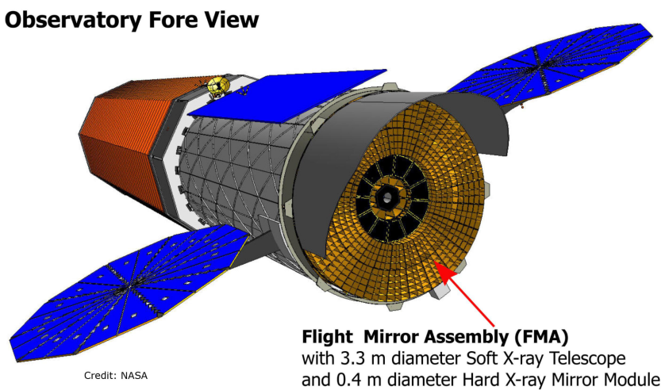
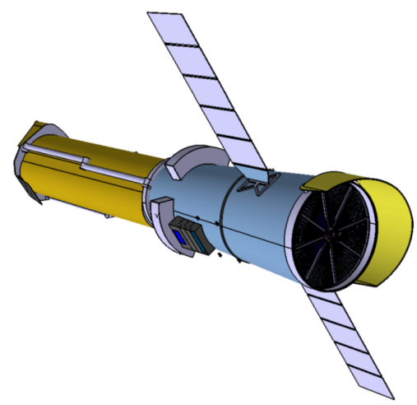
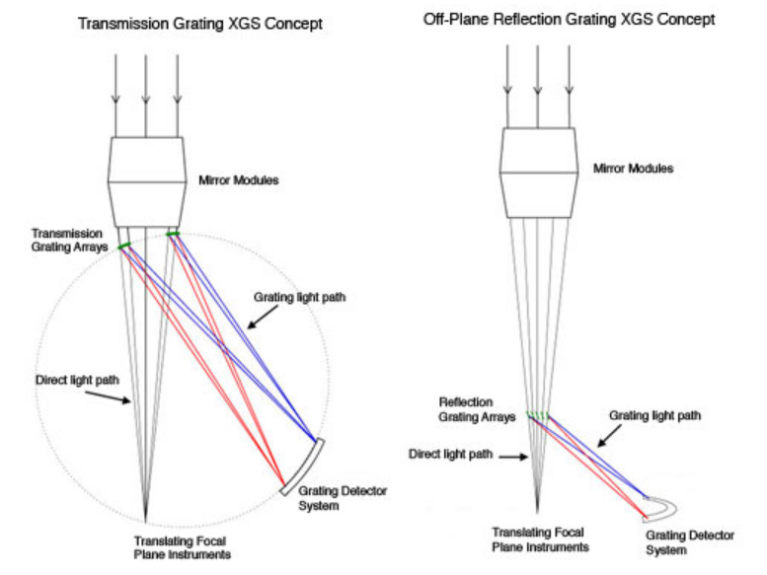
Instruments
  XMS
  XGS
  WFI/HXI
  HTRS
  XPOL

Slide 3
IXO Instrument Key Performance Requirements
Mirror Effective Area | 3 m² @1.25 keV 0.65 m² @ 6 keV with a goal of 1 m² 150 cm² @ 30 keV with a goal of 350 cm² | Black hole evolution, large scale structure, cosmic feedback, EOS Strong gravity, EOS Cosmic acceleration, strong gravity
Spectral Resolution | ΔE = 2.5 eV within 2 x 2 arc min (0.3 – 7 keV) . ΔE = 10 eV within 5 x 5 arc min (0.3 - 7 keV) ΔE < 150 eV @ 6 keV within 18 arc min diameter (0.1 - 15 keV) E/ΔE = 3000 from 0.3–1 keV with an area of 1,000 cm² for point sources ΔE = 1 keV within 8 x 8 arc min (10 – 40 keV) | Black Hole evolution, Large scale structure Missing baryons using tens of background AGN
Mirror Angular Resolution | ≤5 arc sec HPD (0.1 – 10 keV) 30 arc sec HPD (10 - 40 keV) with a goal of 5 arc sec | Large scale structure, cosmic feedback, black hole evolution, missing baryons Black hole evolution
Count Rate | 1 Crab with >90% throughput. ΔE < 200 eV (0.1 – 15 keV) | Strong gravity, EOS
Polarimetry | 1% MDP on 1 mCrab in 100 ksec (2 - 6 keV) | AGN geometry, strong gravity
Astrometry | 1 arcsec at 3σ confidence | Black hole evolution
Absolute Timing | 50 μsec | Neutron star studies

Slide 4
Off-plane geometry

Slide 5
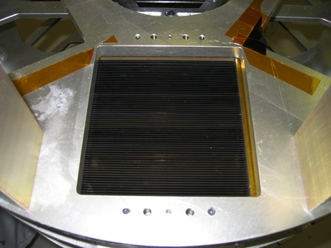
Off-plane flight heritage
Sounding rocket, Cash /Wilkinson, 1992
  Aluminum substrate, 250mm x 100mm x 12mm
  Mechanically ruled, replicated
  1 grating
Sounding rocket, Cash / Gallagher, SCOX1 1993
  Aluminum substrate, 110mm x 110mm x 16mm
  Mechanically ruled, replicated
  4 gratings
Sounding rocket, Catura/Cash, XOGS 1994
  Aluminum substrate, 500mm x 300mm x 3mm
  Mechanically ruled, replicated
  6 gratings per array
-Sounding rocket, Cash/McEntaffer, CYXESS 2006 &
-Sounding rocket, Cash/Oakley, EXOS 2009 (launched on Nov. 13th!)
  EF Nickel substrate, 104mm x 20mm x 127 microns
  Holographically recorded, replicated grooves, 5670 gr/mm
  62 gratings per array x 2 arrays

Slide 7
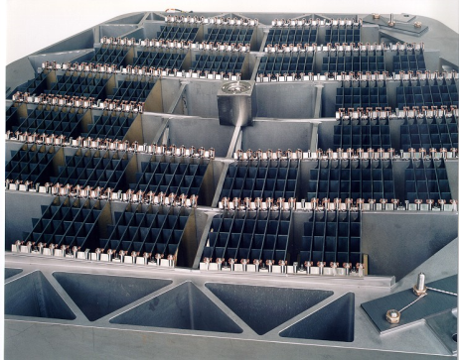
Heritage from XMM-RGS
  Reflection Grating Spectrometer
    182 gratings measuring 100 x 200 mm
    1 mm thin trapezoidal substrates
    Variable line spacing
    Similar mount material
    Similar alignment
    Similar calibration

Slide 8
Previous empirical off-plane data
Off-plane grating development for IXO
  Radial, blazed gratings have been fabricated and efficiency tested (Osterman, et al. 2004). 40% (sum of orders) dispersion efficiency has been obtained. This number used to determine number of gratings used for design.
  Resolution testing has been performed on a telescope limited system (3’ HPD) and a resolution of >200 was obtained. Assuming the grating adds no aberration, a 5” HPD quality telescope puts the resolution at >7200.
  A prototype IXO grating has been fabricated and is awaiting X-ray testing. Efficiency tests will be performed at the University of Iowa upon completion of an X-ray test facility. Also, the grating will be resolution tested in a test facility at Colorado and in the beam of the IXO SXT optics at the GSFC X-ray beamline.

Slide 9
Current OP-XGS activities
With European colleagues, performing ESA Instrument Study
NASA - mirroring efforts of ESA Phase studies
  Currently providing
    Funding to support concept study and preparation of documentation for the ESA study
    Accommodations study for multiple configurations
Concentrate on Trade Study between array placement within observatory

Slide 10
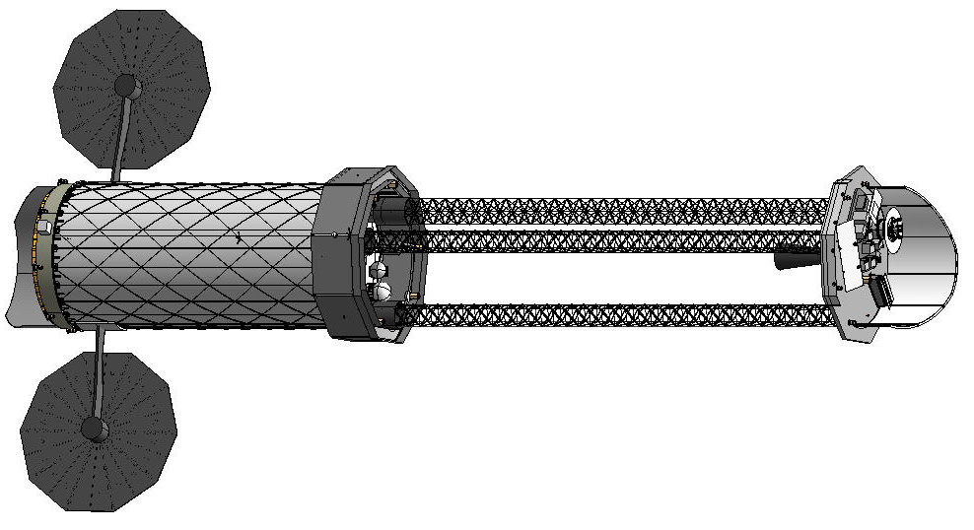
Possible configurations
19.5 m
13.4 m
4.3 m

Slide 11
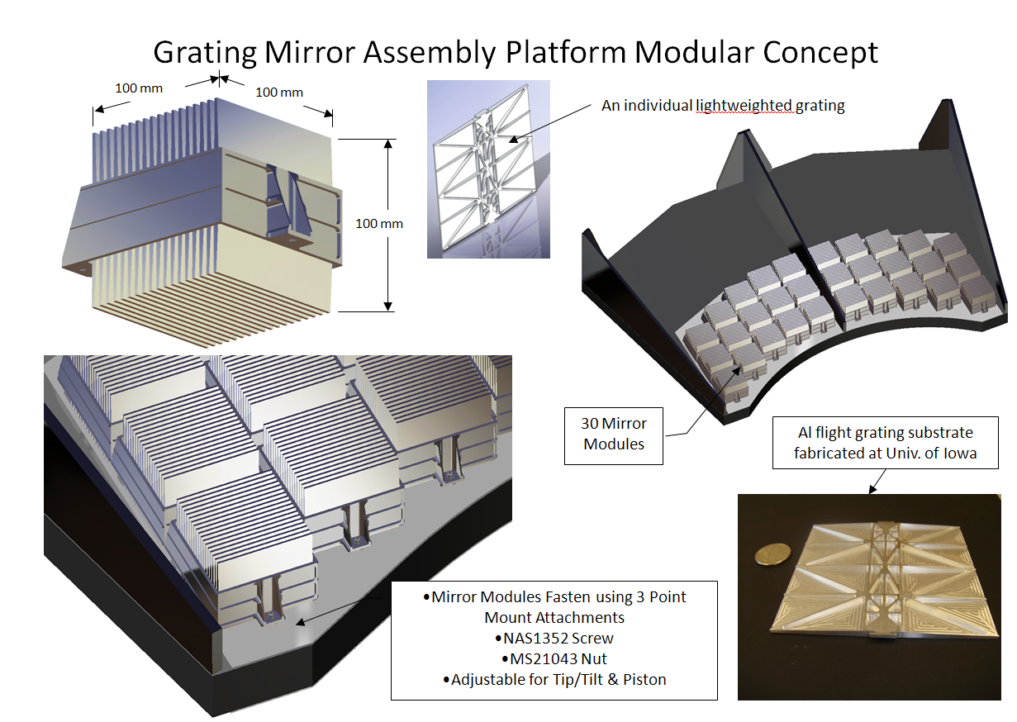

Slide 12
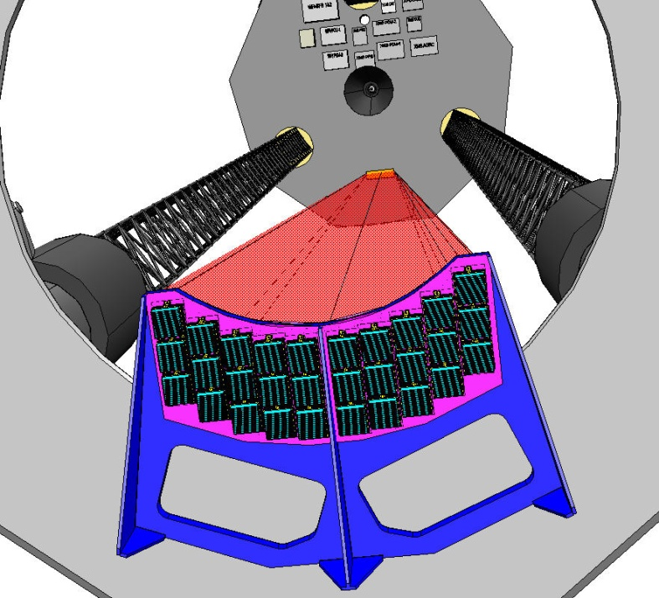
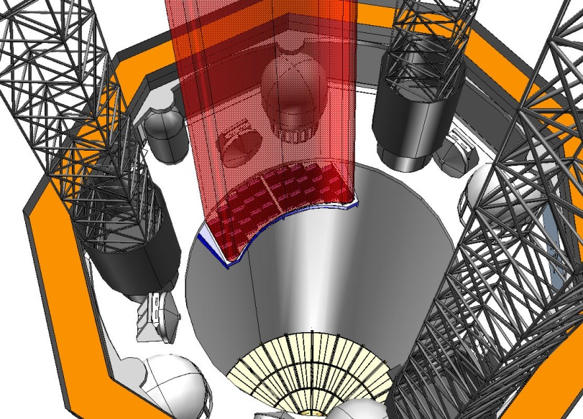
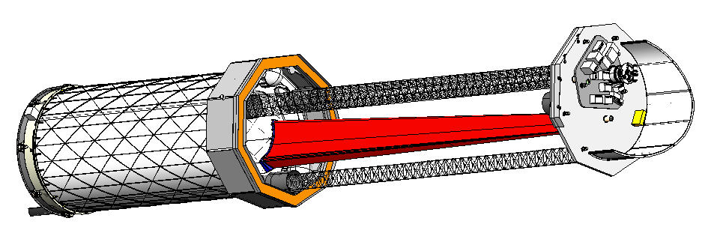
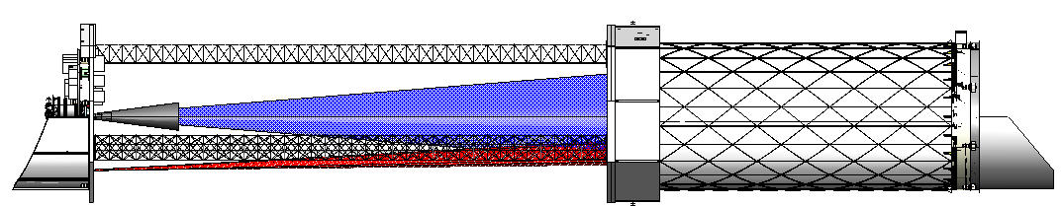
Gratings on the S/C bus, 13.4 m config
13.4 m

Slide 13
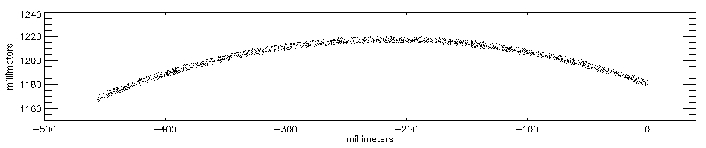
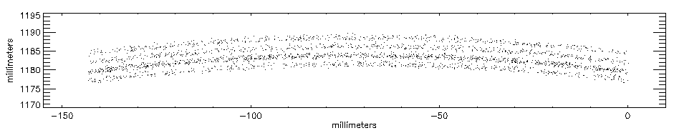
Gratings on the bus, 13.4 m raytrace
4 separate continuum spectra, 5500 gr/mm, λ/Δλ = 9000
62 Å
0 order
4 separate continuum spectra, 1760 gr/mm, λ/Δλ = 3000
All ray traces performed by Webster Cash using IRT at U. of Colorado

Slide 14
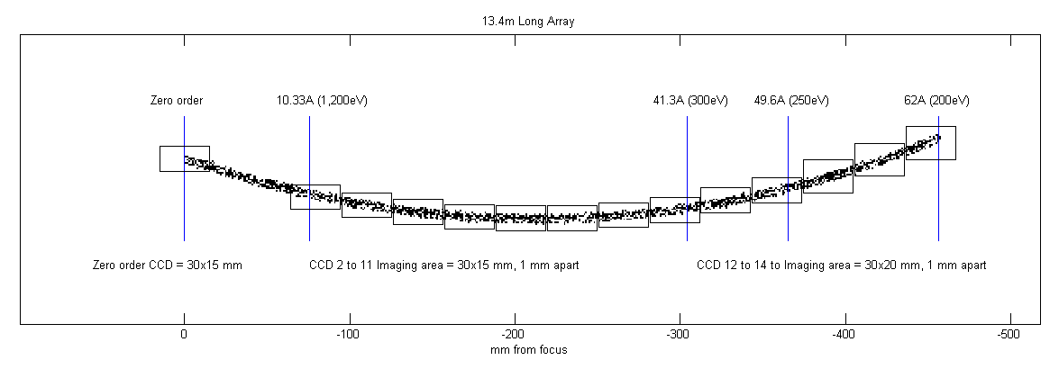
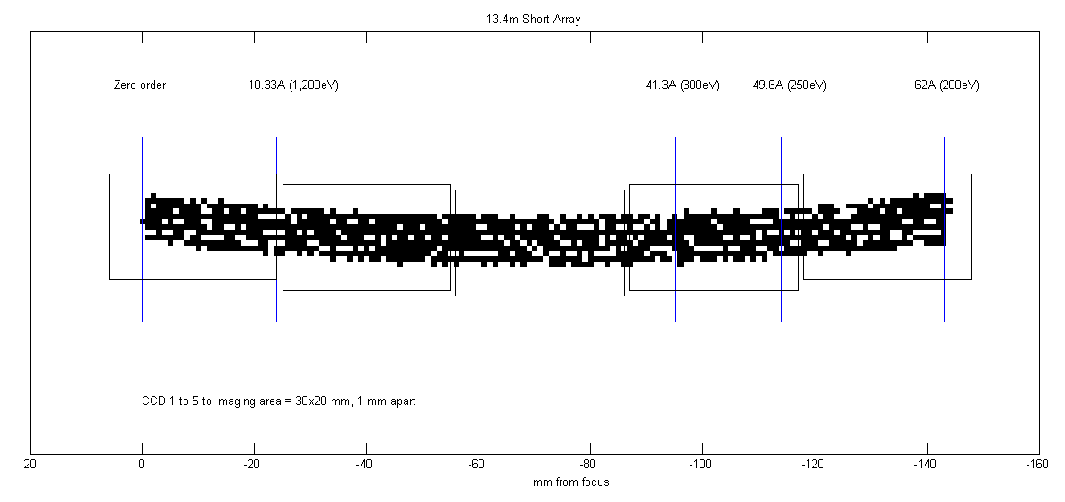
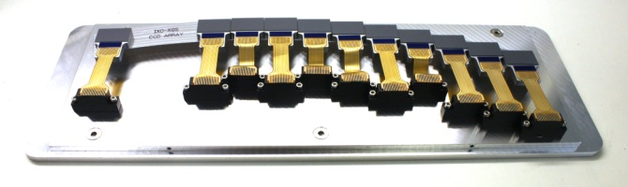
CCD array options for 13.4 m configuration

Slide 15
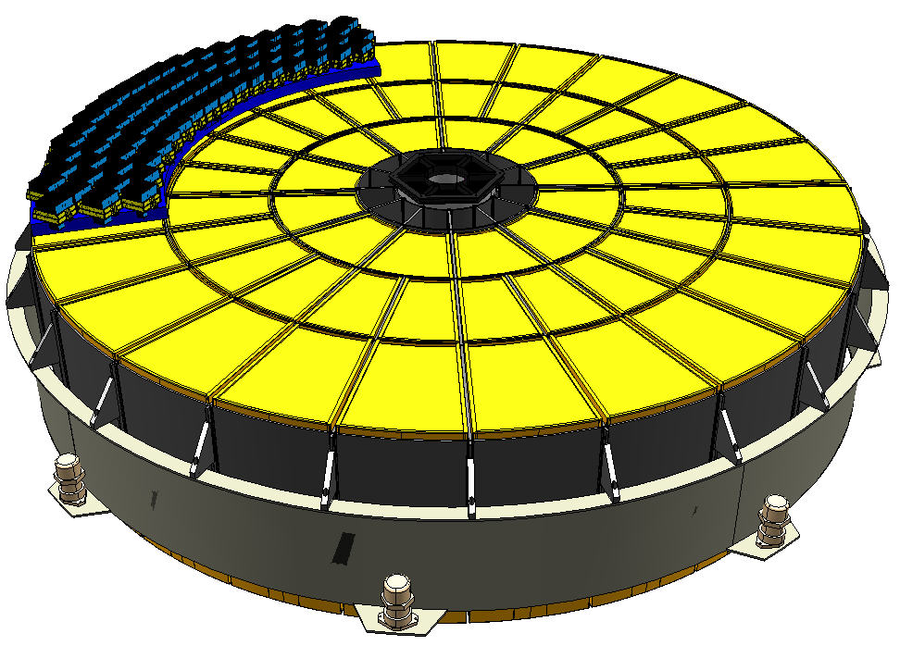
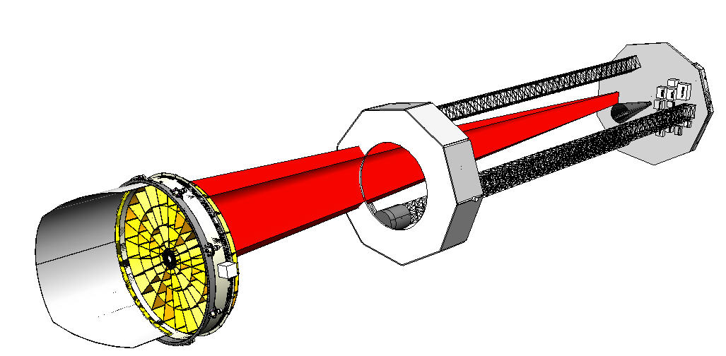
Gratings on FMA, 19.5 m
Gratings mounted to mirrors 19.5 m from focal plane
Project 13.5 m design up to mirrors (same % beam coverage, but more gratings)
1000 cm² using same modules => 2000 gratings, 110 kg in gratings and module mounts
Trade space study between grating surface/alignment tolerances, resolution, and CCD array size
Not ideal
  Mass
  Driving alignment for gratings is gratings to focal plane, not to the telescope.
  Large # of gratings to fabricate, align, calibrate
  Complicates baffles

Slide 16
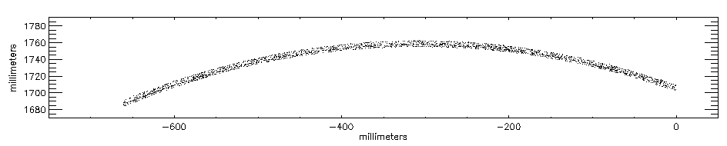
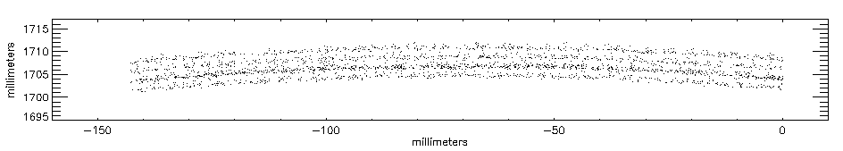
Gratings on FMA, 19.5 m raytrace
4 separate continuum spectra, 5500 gr/mm, λ/Δλ = 13000
62 Å
0 order
4 separate continuum spectra, 1200 gr/mm, λ/Δλ = 3000

Slide 17
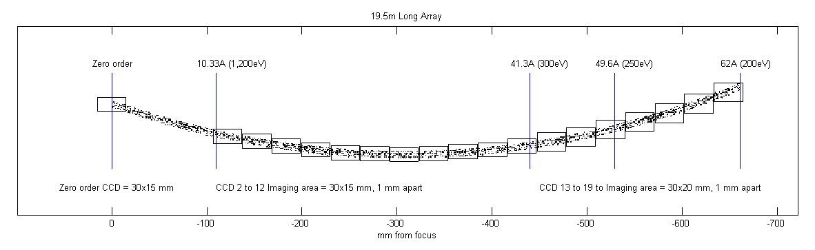
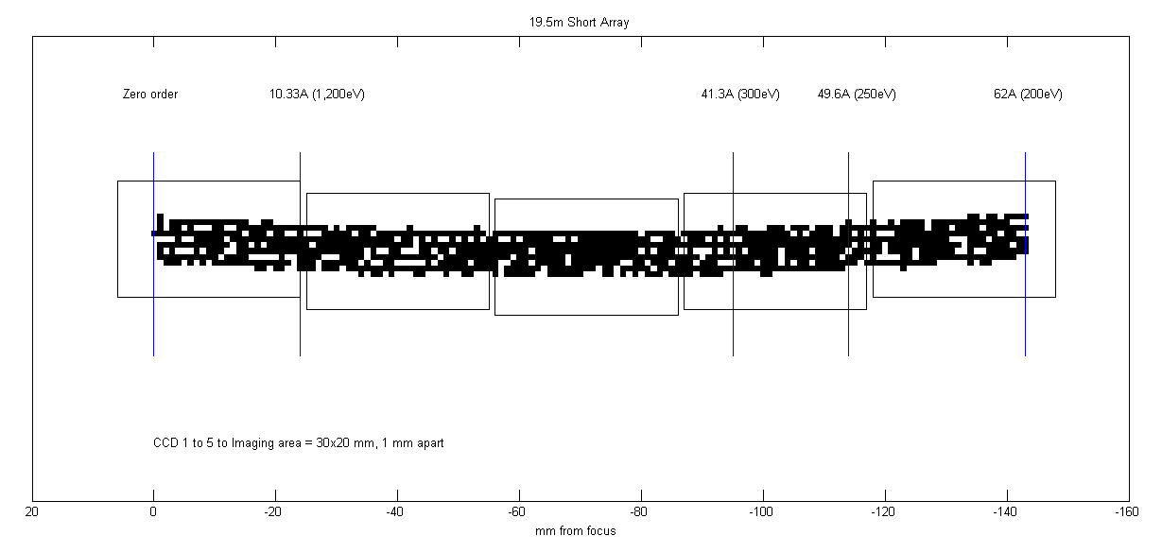
CCD array options for 19.5 m option

Slide 18
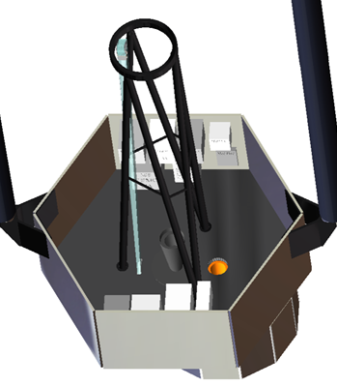
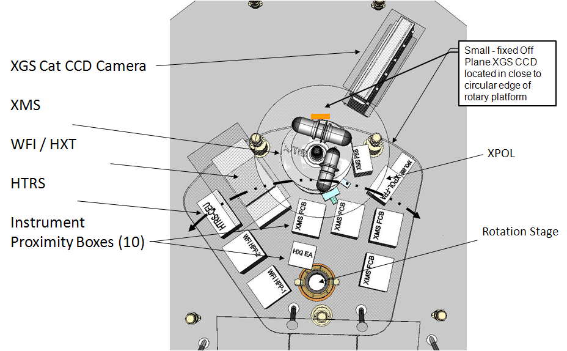
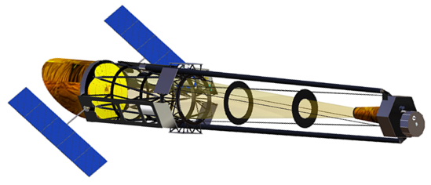
Tower design, 4.3 m

Slide 19
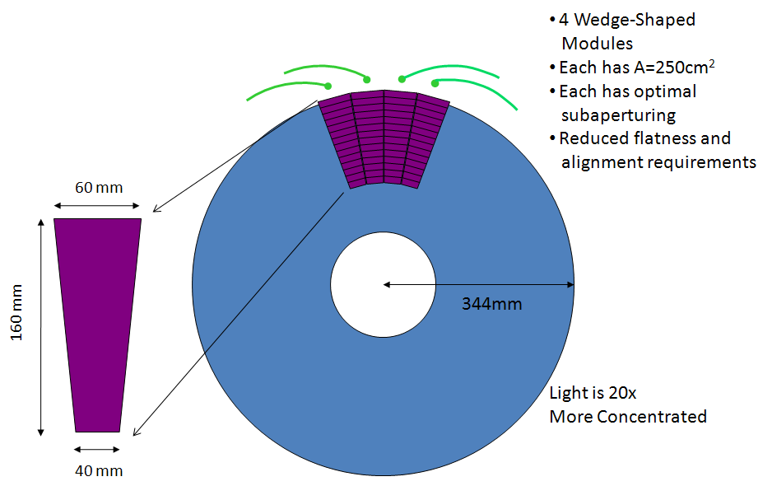
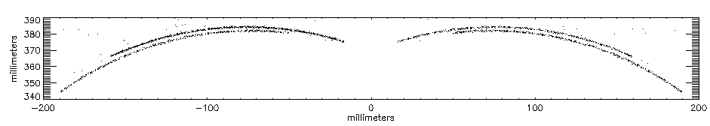
Tower raytrace

Slide 20
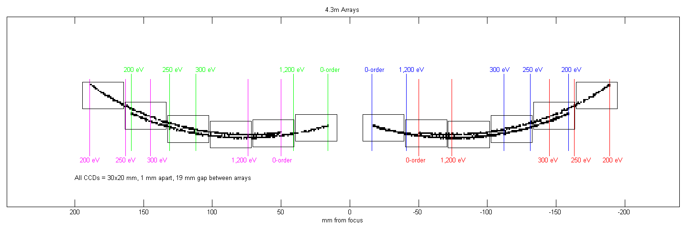
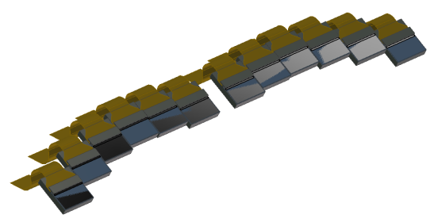
Tower CCD Array

Slide 21
Tower benefits
Low mass
  25 kg (gratings+mounts+tower)
Low obscuration
Easily actuated => more effective area?
Spectral redundancy
Ease of calibration
Easier thermal control
Provides structure for required system architecture
  Charged particle scrubbers, i.e. heavy magnets
  Common baffle (already 3.1 m tower needed)
  MIP instrument cold plates

Slide 22
On-going grating activities
Iowa
  Efficiency testing of IXO prototype gratings
  Fabrication and testing of flight-like substrates (Be substrate meeting flight requirements of weight and flatness) and modules (for alignment studies)
Colorado
  Resolution testing of IXO prototype gratings
  Raytracing various configurations
Northrop Grumman
  Supporting concept studies through construction of engineering models for various configurations, mechanical stability, materials trades, thermal control design, s/c interfaces, etc.
Together with OU/MSSL developing science simulations, .arf, .rmf for verification of design
All preparing documentation for the study

Slide 23
Thank you.

Slide 24
OP-XGS Technology Assessment
TRL | Definition | Hardware Description |  | Exit Criteria
3 | Analytical and experimental critical function and/or characteristic proof of concept. | Analytical studies place the technology in an appropriate context and laboratory demonstrations, modeling and simulation validate analytical prediction. |  | Documented analytical/experimental results validating predictions of key parameters.
 | Off-Plane Reflection Grating Technology Assessment
3 | Theoretical calculations give dispersion efficiency >50% sum of orders (including Au reflection). 40% sum of orders has been obtained empirically for a radial, blazed, high density grating. Theoretical resolution at 1 keV in 3rd order is ~9000. We have obtained an empirical resolution of > 200 at 1keV with a 3’ telescope. Projection to a 5” telescope gives a extrapolated resolution of 7200. | A combination of analytical predictions and laboratory demonstrations shows that Off-plane gratings are capable of obtaining the performance requirements for IXO. Tests were performed in a relevant environment in terms of temperature and vacuum with X-rays, but vibration tests have not been performed. A prototype grating (low fidelity component) has been fabricated but not tested. |  | Experimental results verify analytical predictions and validate the concept for the key IXO XGS performance requirements.

Slide 25
Milestones to achieve TRL 6
Fabrication and testing of a flight prototype grating
  Grating fabricated and tested later this year
  Verification of flight requirements on this grating will increase TRL to 4
Fabrication and testing of a flight prototype array
  Requires fabrication of high fidelity gratings, modules, and array support structure
  This will test alignment scheme and stability
  Environmental and X-ray testing will raise TRL to 5
Fabrication of a grating array engineering unit
  This complete, high fidelity unit will address all scaling issues and undergo environmental and X-ray testing to obtain TRL 6

Slide 26
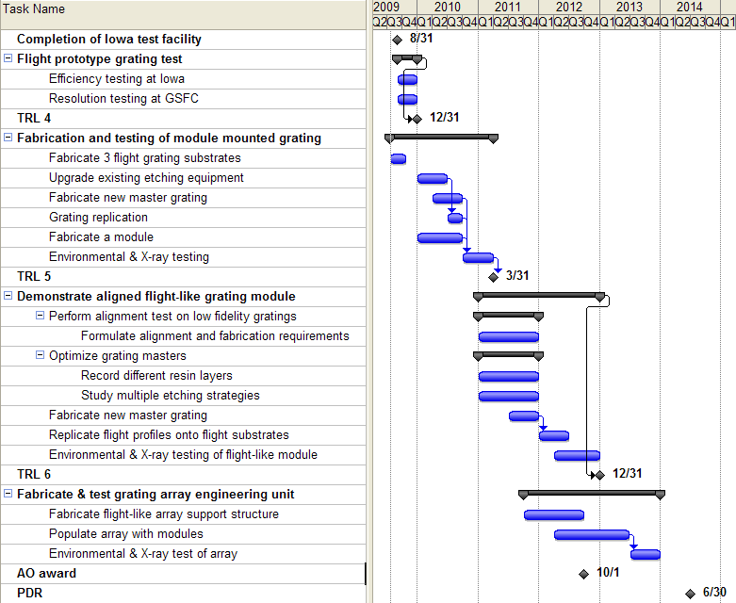

Slide 27
19.5/13.4 m interfaces
Grating Platform requires Redundant (more than 3) mechanical attachments to spacecraft platform to meet required launch frequency
Pinning Required to prevent launch slippage
Grating Platform requires specific flatness to avoid structural distortion during spacecraft mounting (shimmed or machined)
Grating Platform requires noise (Jitter Dynamics) limit at mounting base
Grating Platform requires either Radiative or conductive "Cold Bias" with respect to 20 Degree C temperature set points for stable heater control system function
Platform requires locally mounted heater control electronics box with power & signal I/F
Separate CCD Mounting at Fixed IM with Alignment Required to Grating Platform
Power & Signal I/F Required

Slide 28
4.3 m interfaces
Circular interface base plate for tower requires flat circular mounting flange
Pinning required to prevent launch slippage
Standard flatness control adequate - Tower uses 3 point mount to circular base plate and grating frame will be kinematically mount to tower ring
Circular Platform requires noise (Jitter Dynamics) limit at mounting base
Grating Frame requires Radiative "Cold Bias" with respect to 20 Degree C temperature set points for stable heater control system function
Electronics Box Provisions for CCD and Control electronics will be contained within Tower Mounted OPXGS package
Power & Signal I/F Required

